Slide 1
Whose world is it anyways? Reflections and report on CEA inspired, transnational, interdisciplinary course
Dr. Doris Gray (al-Akhawayn university, morocco) and Garbi Schmidt (Roskilde University, denmark)

Slide 2
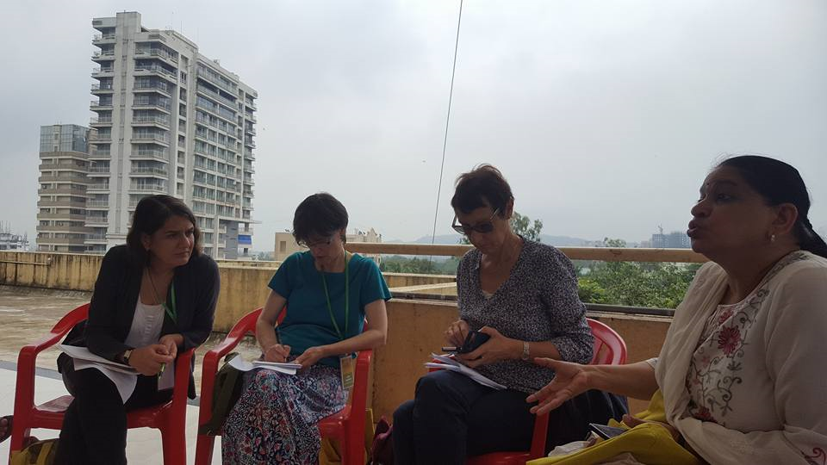
Background
CEA conference, Mumbai

Slide 3
preparation
Convincing two universities that the course in global migration was a good idea
Finding solutions: How to communicate and co-teach in class (and between classes) and allowing students to communicate
Dealing with insitutional differences (number of classes, syllabus, synchronizing class times)

Slide 4
The course
Exploratory course
Multisited teaching and group work (Ambition)
Online course platform for sharing materials
Faculty exchange
Allowing the students to meet and learn from refugees and immigrants
Involvement with migrantion project

Slide 5
Positive results
Allowing students to Understand a phenomenon with global impact from more than one national perspective
Allowing students to work with (sometimes) unfamiliar methods
PROJECT BASED LEARNING – COMMUNITY SERVICE INVOLVEMENT
Critical perspectives on preconceptions
Allowing students to work together
Faculty exchange – cea networking in action

Slide 6
challenges
Creating sychnorncity
Difference in instututional course design (frequency of meeting times, attendance requirements, identifying similar projects)
Technology (Online platform, sound and video equipment)
Enhancing cocommunication between students
Ad hoc adjustments
RU: students having signed up for more than one course (taking place at the same time)
Institutional support (transport to project site, release time from other courses, tech support, flexibility with assigning course time etc)

Slide 7
For the future
Is this something that CEA wants?
How may cea support (tech, admin, funding)?
How to deal with inequalities (universities in global north and global south)?
How can we develop similar courses together? Including more universities, or?
What support should we expect from our departments and universities?

Slide 8
Outcomes
community Engaged learning
- multi-, inter-, trans-disciplinary course
- transnational collaboration (Global North and Global South)
- transformative educational experience (cognitive, affective, behavioral change learning)
- education for the future
- focusing on pressing contemporary issue (refugees, migration)

Slide 9
Specific outcomes
Ability to discuss major issues in as they relate to politics and migration discourse.
Evaluate migration policies and their implications for the Morocco and Denmark.
Conduct basic field work.
Understand how politics, economic participation, social status, and gender influence new ways of conceptualizing quality of life.
Develop critical analytical and thinking skills in women, gender, politics and migration.
Integrate concepts and lived realities of migrants in Denmark and those in Morocco
Understand alternative models of migration policies
Understand the role of social change movements in the evolution of migration practice and principles.

